Slide 1
Prompt
Engineering
-LLM Whisperers

Slide 2


01
Problem Statement
02
Prefix tuning
03
Dataset used
04
Experimental setup
T
0
Revisiting the problem statement and the project aim
Revisiting the concepts of Prefix Tuning
A brief discussion of the datasets.
The architecture used

Slide 3
05
Metrics of evaluation
06
Results
07
Challenges faced
08
Observation and analysis
T
0
A brief discussion on BLEU and METEOR scores.
Challenges faced while experimentation
Scores obtained for various parameters
Observations and analysis interpreted from Results

Slide 4
01
Problem Statement
T
1

Slide 5
T
1
The aim of the project is design a prompt which steers the LM to desired NLG task.​
Since Prefix tuning is a task specific prompting method, we have decided to experiment on Language Translation.​​
Languages Considered ?
Hindi - English and vice versa
French - English and vice versa

Slide 6
02
Prefix
tuning
T
1

Slide 7
T
1
What is Prefix?
What is meant by Prefix tuning?​
Intuition​ ?
Based on intuition from prompting, we believe that having a proper context can steer the LM without changing its parameters. Extending this intuition.​

Slide 8
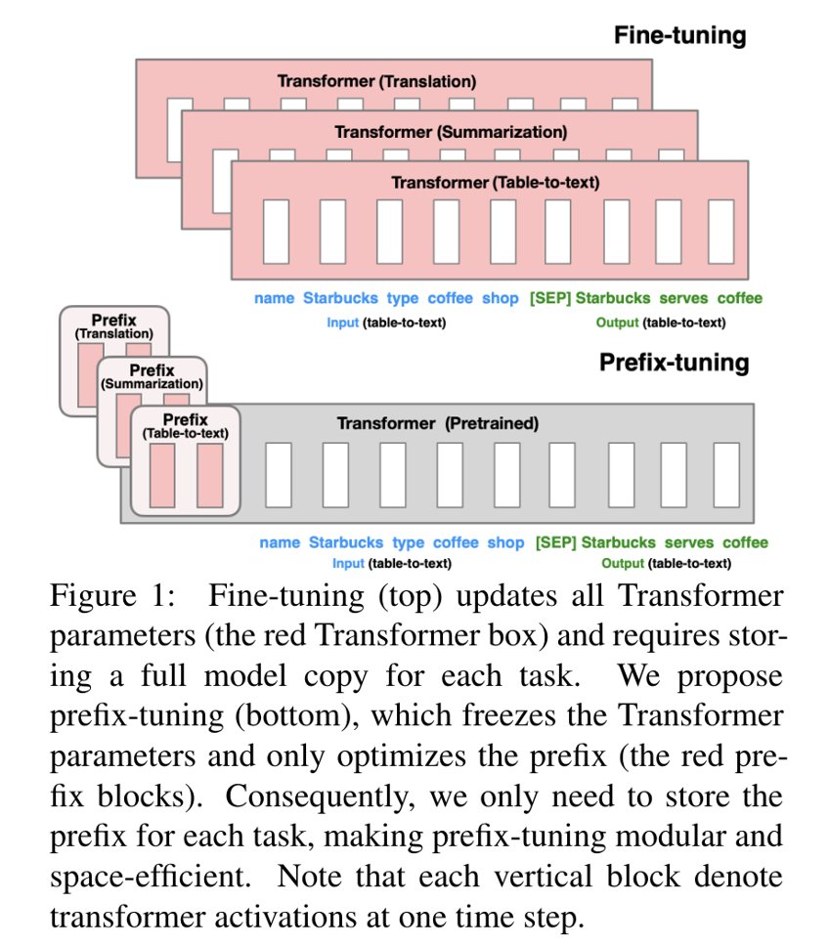
T
1
An Overview of Prefix Tuning

Slide 9
03
Dataset
Used
T
1

Slide 10
T
1
Hindi - English Translation:-
IIT Bombay English-Hindi Translation Dataset - It contains 1,561,840 instances of Hindi - English Translation
French - English Translation:-
English-French Translation Dataset- Over 22.5 million sentences in French and English.

Slide 11
04
Experimental
setup
T
1

Slide 12
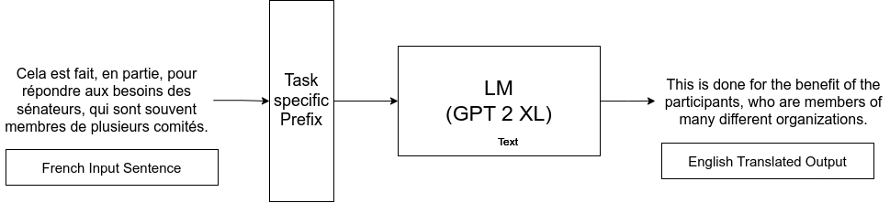
T
1
We have kept the number of tokens for each learned prefix as -
16
32
for both the Hindi-English and French -English language translation tasks.
Program Architecture

Slide 13
05
Metrics of Evaluation
T
1

Slide 14
T
1
BLEU(Bilingual Evaluation Understudy):-
Bleu measures the similarity between a candidate machine translated text and one or more reference (human translated) texts. The score is between 0 to 1, with 1 being perfect translation.
Does not measure semantic accuracy or fluency. Human evaluation is still required for these aspects.

Slide 15
T
1
METEOR(Metric for Evaluation of Translation with Explicit ORdering):-
Meteor measures the similarity between a machine translated sentence and reference human translations by considering exact word (or phrase) matching as well as stemmed and synonymous matches.
METEOR shows a slightly better correlation with human judgment than BLEU, however, it relies on language-specific paraphrase tables. The quality of the table heavily influences the evaluation quality.

Slide 16
06
results
T
1

Slide 17
T
1
Bleu Score Comparisons between different models
Task and Parameters | Tuned Model | K-shot Model
English-Hindi token length =16 | 0.023340257043143433 | 0.016611024066471424
English-Hindi token length =32 | 0.0537013264396293 | 0.036188673930951334
English-French token length =16 | 0.3588867595233152 | 0.276690231568923021
English-French token length =32 | 0.34153207748487424 | 0.2675896527715929

Slide 18
T
1
Meteor Score Comparisons between different models
Models Tried | Tuned model | K-shot Model
English-Hindi token length =16 | 0.023340257043143433 | 0.016611024066471424
English-Hindi token length =32 | 0.023554671445517605 | 0.016611024066471424
English-French token length =16 | 0.22811963153760054 | 0.1508380019541109
English-French token length =32 | 0.22304764823829515 | 0.1508380019541109

Slide 19
T
1
Bleu Score Comparisons between same model with different iterations
Task and Parameters | Tuned Model | K-shot Model
English-Hindi token length =16 1024 iterations | 0.023340257043143433 | 0.016611024066471424
English-Hindi token length =16 2048 iterations | 0.08726462188440703 | 0.036188673930951334

Slide 20
T
1
Meteor Score Comparisons between same model with different iterations
Models Tried | Tuned Model | K shot Model
English-Hindi token length =16 | 0.023340257043143433 | 0.016611024066471424
English-Hindi token length =32 iterations =2048 | 0.03695241928016461 | 0.016611024066471424

Slide 21
07
Challenges
T
1

Slide 22

Challenges
T
3
We started off with a huge LM(GPT-3 equivalent) but leading to unexpected crash which we later figured out was due to limit on our RAM usage. Hence we later shifted to a lighter model
We also tried using API, but it was taking a lot of time and there are limited free API calls to make. Hence we had to run models locally.
Using an extensive language translation dataset to capture all the intricacies of a translation task. Finding such a dataset was also a challenge in itself.

Slide 23
Challenges
T
3
Unreasonable GPU power and RAM requirements demanded by language models.
High Runtime for both training and calculating evaluation metrics.
Analysis of results

Slide 24
08
Observations and analysis
T
1
You can enter a subtitle here if you need it

Slide 25
Observations
T
3
Prefix Tuning works better compared to K-shot model.
BLEU score is always higher compared to Meteor score for the same instance.
English-to-french translation and vice versa have better results compared to English-to-hindi and vice versa.
Increase in the iterations increases your BLEU and Meteor Score.

Slide 26
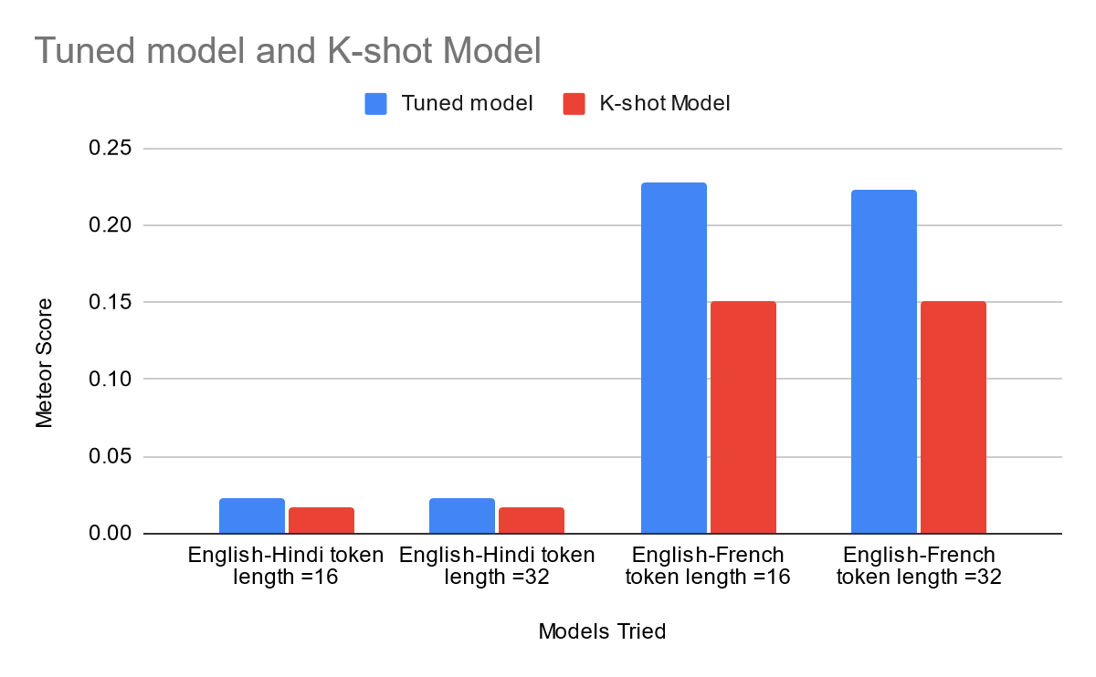
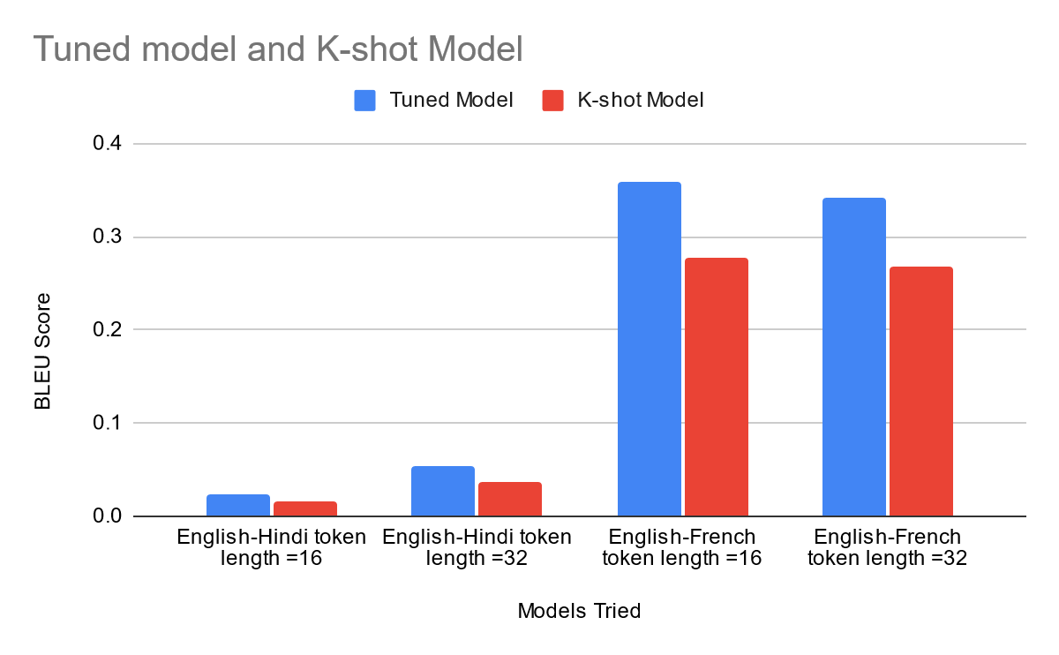
Visualizing
results

Slide 27
Analysis
T
3
BLEU places a strong emphasis on precision based on n-grams. Since the reference translation is shorter than the machine-generated translation and the overlapping n-grams are correct, This explains why the bleu score is consistently higher than the meteor score.
English-French translation, both ways, tends to yield better results compared to English-Hindi due to a significant bias in the volume of available data. The disparity in the sizes of English-French and English-Hindi datasets plays a crucial role in this performance discrepancy.

Slide 28
Analysis
T
3
Prefix fine-tuned model outperforms the k-shot language model as the empirical study shown in the paper shows that fine tuning the prefix layer for task specific tasks is much faster and gives comparable performance to fine tuning all of the parameters of the language models which is time taking and space consuming.
Prefix tuning also lets us handle special tokens in sentences efficiently compared to that of k-shot prompting method.

Slide 29
09
Examples
T
1

Slide 30
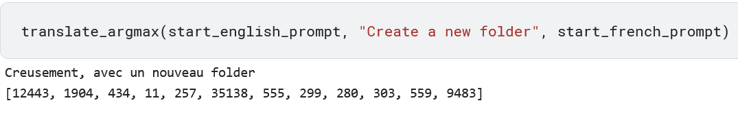
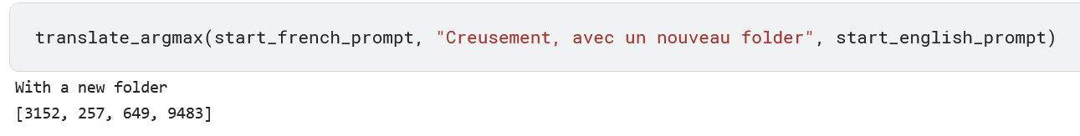
Tuning length 16 and iterations =1024 :-

Slide 31
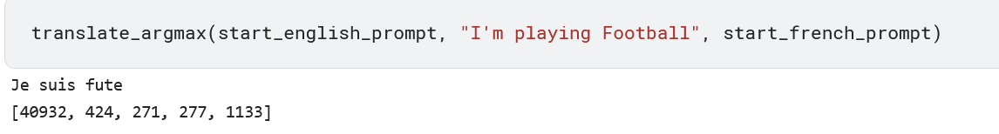
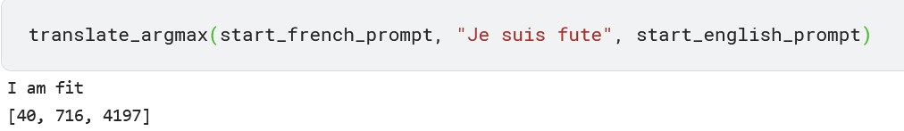
Tuning length 32 and iterations =2048 :-

Slide 32
Thanks
T
1

